Slide 1
Art and Storytelling
Education Resources
Compiled by:
Amy McClurd

Slide 2
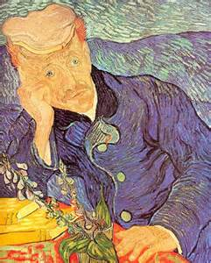
Introduction
Introduction to “The Portrait of Dr. Gachet: My Story vs. van Gogh’s Story”
Why I selected this topic?
Who is the potential audience?

Slide 4
Art tells a story – Museum of Toledo
http://www.toledomuseum.org/wordpress/wp-content/uploads/Art-Tells-a-Story.pdf

Slide 5
Art That Tells a Story – PBS Learning Media
http://www.pbslearningmedia.org/resource/echo07.lan.stories.art/art-that-tells-a-story/

Slide 6
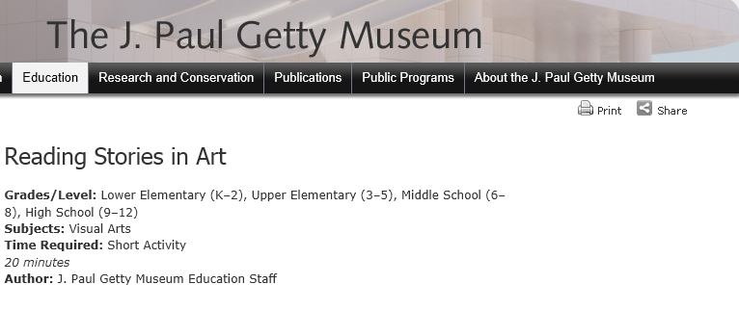
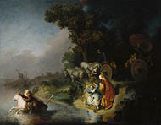
Reading stories in Art – The Abduction of Europa
http://www.getty.edu/education/teachers/trippack/activity_pre_storiesinart.html

Slide 7
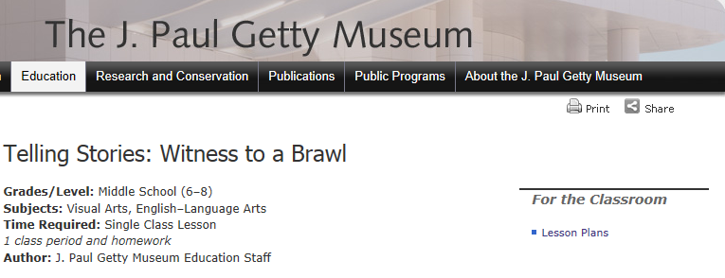
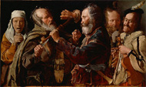
Telling stories in Art – Witness to a brawl
http://www.getty.edu/education/teachers/classroom_resources/curricula/stories/

Slide 8
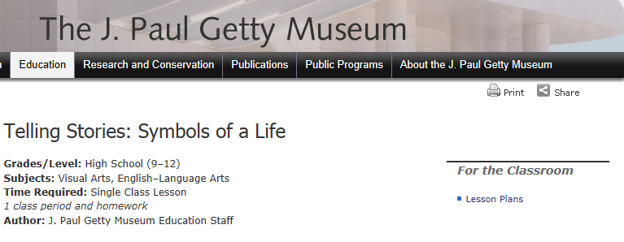
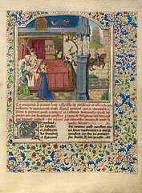
Telling stories – Symbols of a life
http://www.getty.edu/education/teachers/classroom_resources/curricula/stories/

Slide 9
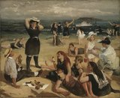
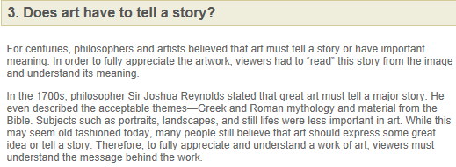
Does arT have to tell a story?
http://schools.walkerart.org/swita/switaact3.html

Slide 10
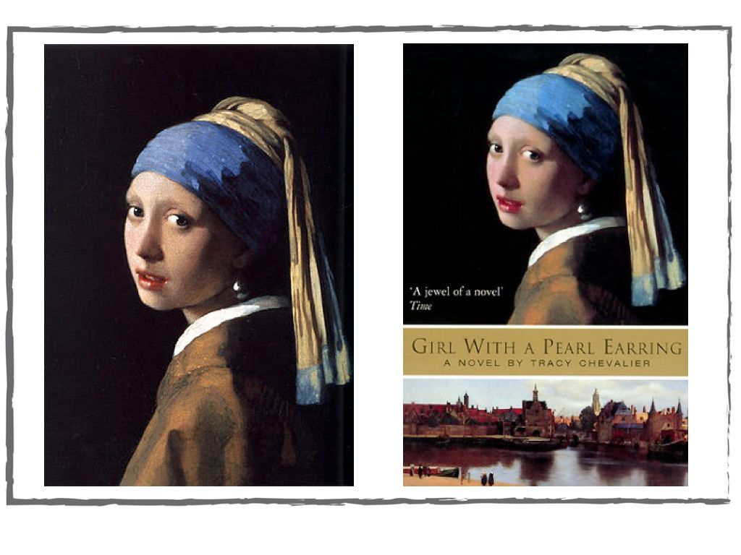
Tracy Chevalier: Finding the story inside the painting – Ted Talk
http://www.ted.com/talks/tracy_chevalier_finding_the_story_inside_the_painting.html

Slide 11
Video: Stories – art 21
http://video.pbs.org/video/1237715781/

Slide 12
The artist gazes upon a reality and creates his own impression. The viewer gazes upon the impression and creates his own reality.
~ Robert Brault

